Slide 1
What are Razor Pages
In 2016, Microsoft released ASP Dot Net Core as an open source ,cross platform, and modular framework for development of web application, web services, mobile back-ends, and IoT applications.

Slide 2
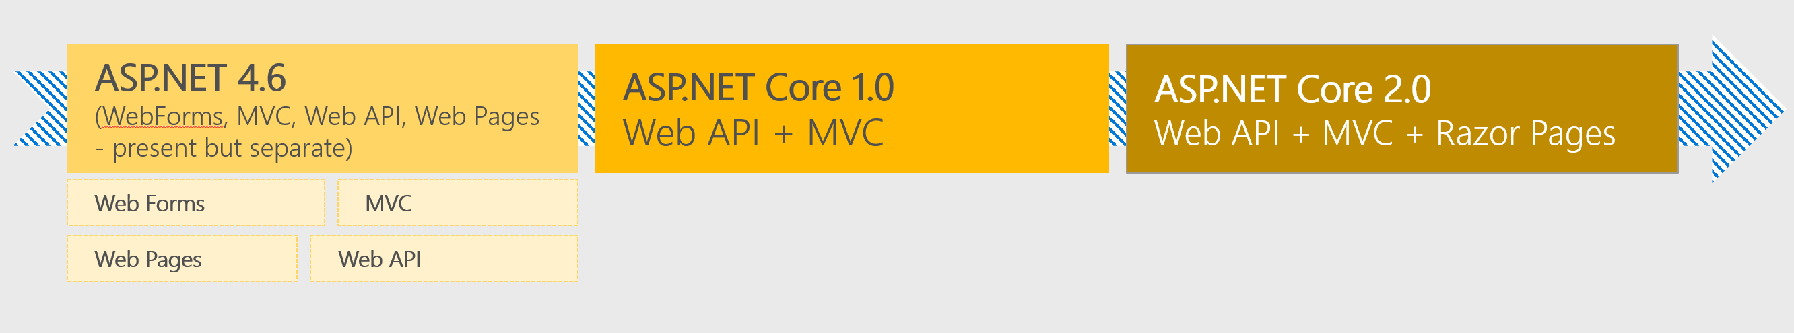
What are Razor Pages
ASP Dot Net Core 2.0 comes with a new feature called Razor Pages.
Razor Pages are “a new coding paradigm” that makes writing page-focused scenarios easier and simpler than the underlying Model-View-Controller architecture (MVC).”

Slide 3
What are Razor Pages
A Razor Pages App is designed as a page-based coding model.
The entire code of a web page is stored in a single file.
The file defines the URL structure of the entire app.
Razor Pages are built on top of MVC, However, it lacks some of the robust features provided by ASP.NET Core MVC.
The coding paradigm contains both models and controllers in a single file : PageModel

Slide 4
What are Razor Pages
With Razor Pages, you can benefit from MVC features like :
Model binding
Tag helpers,
HTML helpers,
Handlers (action methods).
Razor Pages application using ASP Dot Net MVC syntax and functionality.

Slide 5
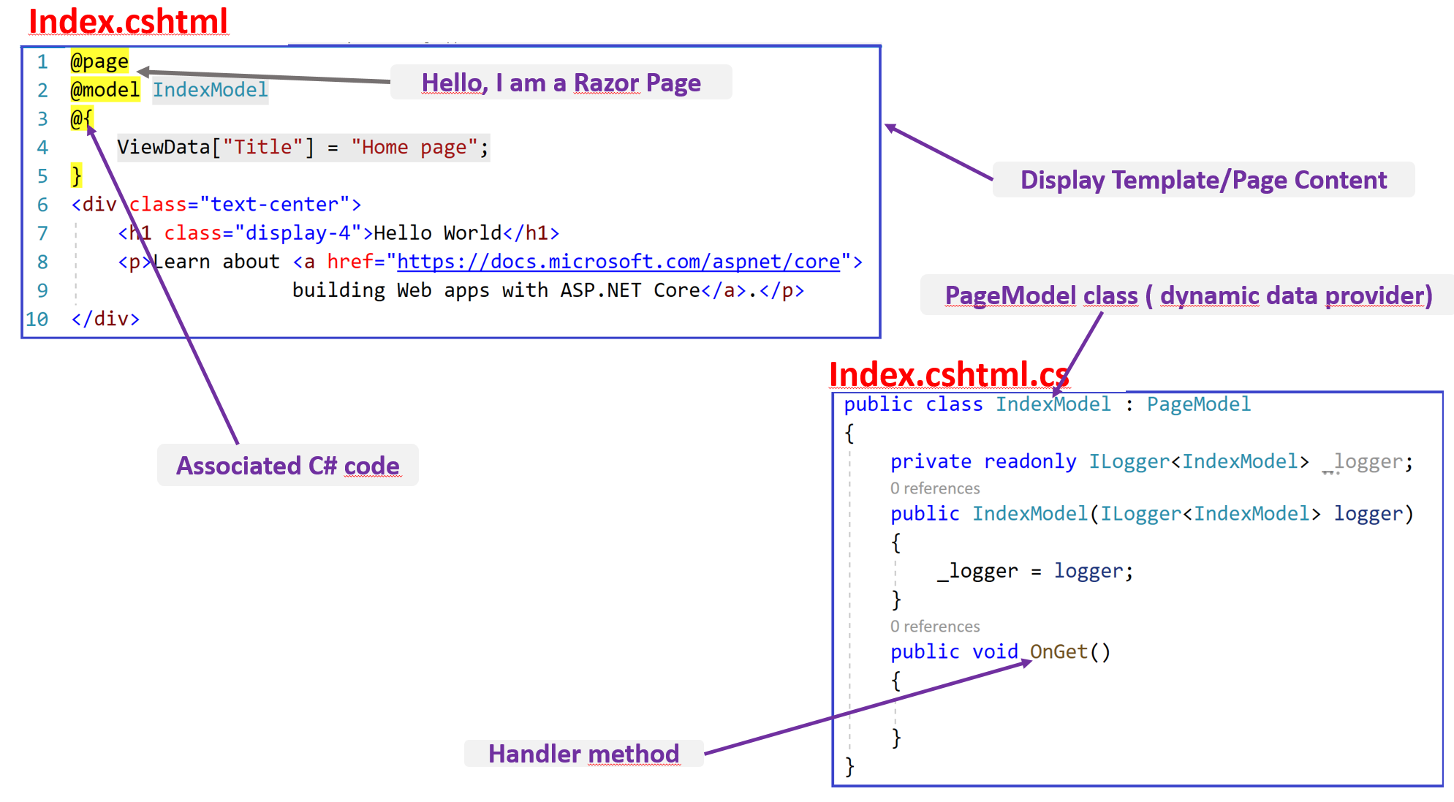
A Simple Razor Page

Slide 6
Demo 1 : Hello World App
Create your first Razor Pages application.
In the display template ( the page), hard code the ”Hello World” message
Run your first application.
Explain the code execution sequence( Where the app strats and where it ends). Use breakpoints

